Slide 1


Deep Learning with Tensorflow
Usman Khan
@ByteWise
Notes:
[Add your name and photo here]
Hi everyone, my name is Wolff and I'm going to tell you about TensorFlow from the Ground up.
This talk is designed for people who know the basics of ML, but need an overview of the basics of TensorFlow. We're not going to do a lotta math, here, but we will do a bunch of code. Ready?

Slide 2



About the Lead
Usman Khan
Google DSC Lead - NUML
Regional Lead EMEA @ Microsoft Learn
Technical Lead @ MLSA Islamabad
Big Data Engineer @ Blutech Consulting
3+ Years of Experience in ML, NLP and Python

Slide 3
What are we even doing?
Notes:
Why do you need TensorFlow? So, what are we even doing here?

Slide 4

Probably machine learning.
Notes:
In this case, we're probably doing machine learning. There are other things you can do with TensorFlow, but we'll be sticking to ML.

Slide 5

What even is Machine Learning?
Machine Learning is the process of building models that can understand & predict patterns in text, numeric or visual data.

Slide 6
Types of Machine Learning
Supervised
Regression
Classification
Unsupervised
Clustering
Dimensionality Reduction
Reinforcement Learning
Real-Time Decision making
Works on reward/punishment model

Slide 7


Slide 8
What is Deep Learning?
This subset of AI is a technique that is inspired by the way a human brain filters information.
It is associated with learning from examples. DL systems help a computer model to filter the input data through layers to predict and classify information.
Deep Learning processes information in the same manner as the human brain.

Slide 9
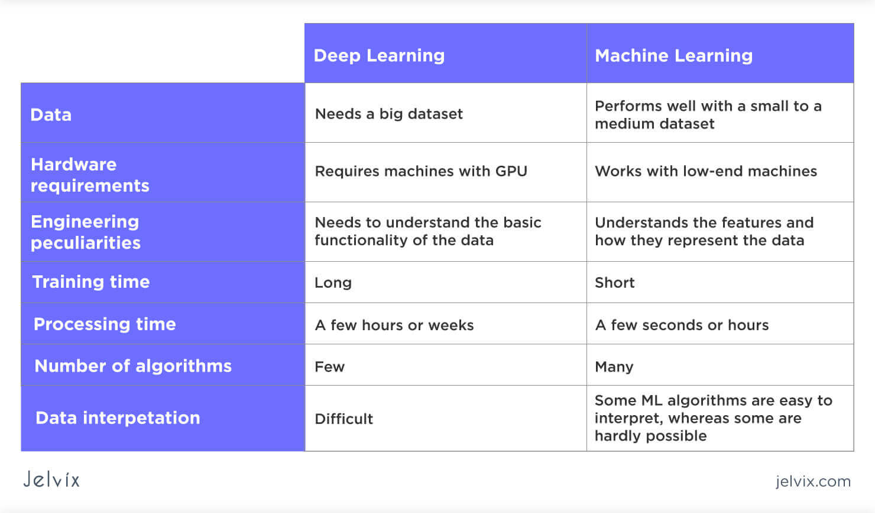
Comparison

Slide 10
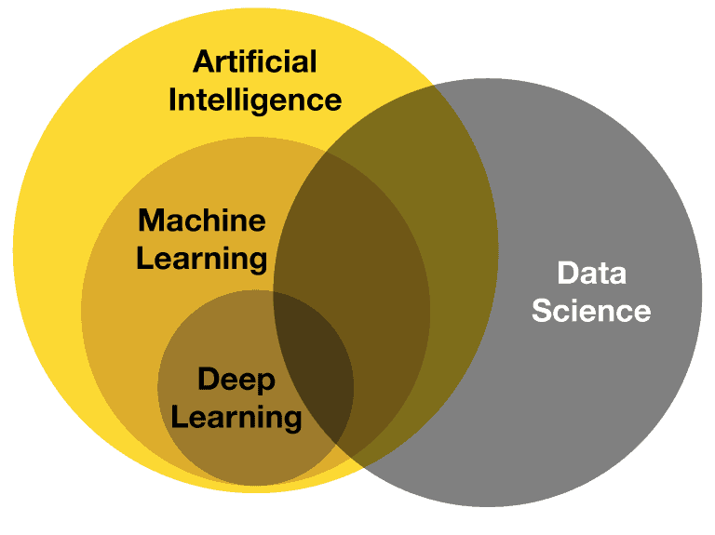

Slide 11
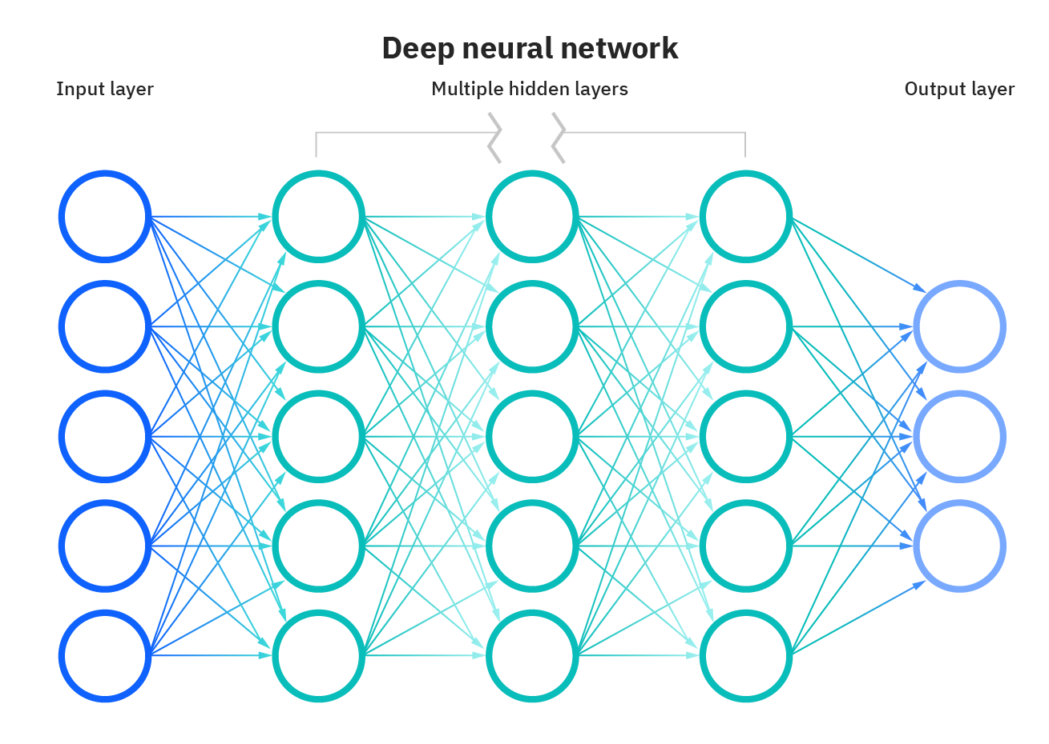
Neural Networks
Neural networks, also known as artificial neural networks (ANNs) or simulated neural networks (SNNs), are a subset of machine learning and are at the heart of deep learning algorithms. Their name and structure are inspired by the human brain, mimicking the way that biological neurons signal to one another.

Slide 12
Structure
Artificial neural networks (ANNs) are comprised of a node layers, containing an input layer, one or more hidden layers, and an output layer. Each node, or artificial neuron, connects to another and has an associated weight and threshold. If the output of any individual node is above the specified threshold value, that node is activated, sending data to the next layer of the network. Otherwise, no data is passed along to the next layer of the network.

Slide 13
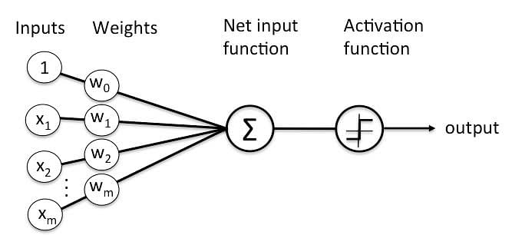
Perceptron
Perceptron was introduced by Frank Rosenblatt in 1957. He proposed a Perceptron learning rule based on the original MCP neuron. A Perceptron is an algorithm for supervised learning of binary classifiers. This algorithm enables neurons to learn and processes elements in the training set one at a time

Slide 14
Perceptron Function
Perceptron is a function that maps its input “x,” which is multiplied with the learned weight coefficient; an output value ”f(x)”is generated.

Slide 15
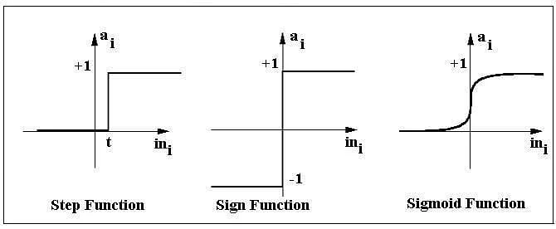
Activation Function
The activation function applies a step rule (convert the numerical output into +1 or -1) to check if the output of the weighting function is greater than zero or not.

Slide 16
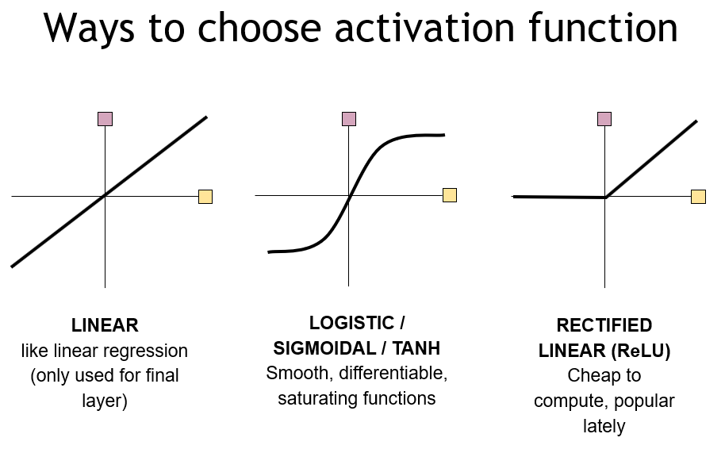

Slide 18
The arc of deep learning
Data
Collect some data
Represent weights (parameters)
Build a model out of groups of weights
Train those weights with MATH
Accelerate that training so it finishes
Model
Weights
Training
Accelerators
Notes:
So when we're doing machine learning, we think about the arc of the workflow.

Slide 19
TensorFlow has a lot going on
We have a lot of methods, classes, and functions(thousands)
We have Keras and Sonnet if you need high-level APIs
We have a lot of packages: Probability, TFX, Lite, JS, Agents, Privacy, and lots more
We even have tf.numpy
But, how do you get your head around the design of the entire system?
Notes:
TensorFlow has a lot going on
....read bullets, then end on "Fundamentally what do you need to know"
Fundamentally, what do you need to know?

Slide 20
3 Easy Pieces
tensors
variables
modules
We'll teach it to you right now!

Slide 21
3 features to remember
tensors: Representing some data
variables: Representing weights
modules: Building a model

Slide 22
1. Tensors
A static numerical representation
Notes:
Let's start with Tensors

Slide 23
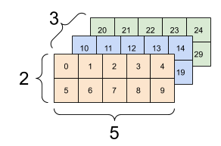
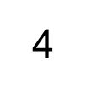
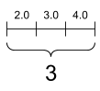
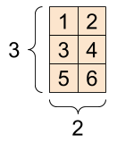
What's a tensor?
["hat",
"coat"]
Notes:
Tensors are multi-dimensional arrays are strongly typed (called a dtype).
If you're familiar with NumPy, tensors are (kind of) like nd.arrays.
Everything you see here is a tensor.

Slide 24
Tensor are strongly-typed
Strongly-typed
floats of various kinds
booleans
ints of all sorts
complex numbers
strings
...other exotic kinds like Sparse and Ragged
Immutable
Notes:
Tensors are strongly typed, with ints, and complex, and strings, and exotic tyles.
All tensors are immutable like Python numbers and strings: you can never update the contents of a tensor, only create a new one.
Why do we need tensors?

Slide 25
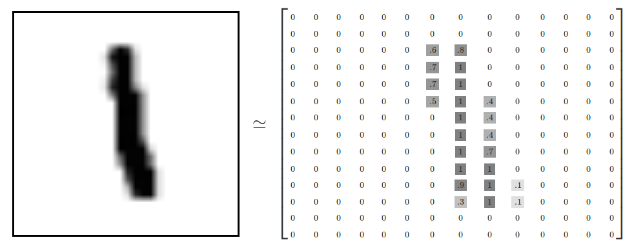
We see
Computer “sees”
Notes:
Here, we have an image converted into a float tensor---each pixel value turns into a floating point number in a big matrix.
We use tensors to represent whatever it is that we're trying to operate on. Images turn to tensors, sounds turn to tensors, text turns to tensors. Tensors are also fast, they can be vectorized, and they can use accelerators.

Slide 26
# This will be an float tensor by default
rank_0_tensor = tf.constant(4.0)
# Let's make a rank_1 tensor, which is like an array
real = tf.constant([2.25, 3.25])
imag = tf.constant([4.75, 5.75])
# Let's make a complex tensor
tf.complex(real, imag) # [[2.25 + 4.75j], [3.25 + 5.75j]]
# String tensor
rank_2_tensor = tf.constant([["fruit", "bat"],
["fuzzy", "cat"],
["gray", "wolf"]], dtype=tf.string)
Notes:
Let's see what that looks like in code.
Here, we are defining three tensors, each of different ranks---which is to say, how many dimensions they have.
[look through slide]
A rank 0 tensor is a scalar
A rank 1 tensor looks like an array
We can put two rank1 tensors together to form a rank 1tensor with complex values
Here, we have a rank-2 tensor that describes word pairs.

Slide 27
# There can be an arbitrary number of
# axes (sometimes called "dimensions")
rank_3_tensor = tf.constant([
[[0, 1, 2, 3, 4],
[5, 6, 7, 8, 9]],
[[10, 11, 12, 13, 14],
[15, 16, 17, 18, 19]],
[[20, 21, 22, 23, 24],
[25, 26, 27, 28, 29]],])
Notes:
We can keep going to arbitrarily large sizes and dimensions. You've may have noticed I'm using rank and dimensions to describe the bounds of a tensor, this is sort of a 3-dimensional tensor.
Python array printouts begins to be hard to visualize, and I hope you like square brackets.

Slide 28
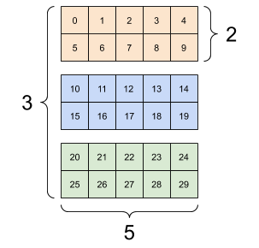
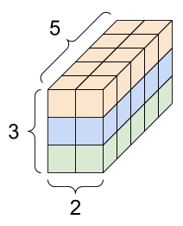
Rank-3 tensor
Notes:
So, we can visualize this a couple of different ways. As you can see, this rank-3 tensor doesn't necessarily describe what you'd classically think of as a 3D space.
Instead, it might be a batch of three 2x5 examples of your data, or else something entirely different.

Slide 29
Tensor features
Shape: The length (number of elements) of each of the dimensions of a tensor.
Rank: Number of tensor dimensions. A scalar has rank 0, a vector has rank 1, a matrix is rank 2.
Axis or Dimension: A particular dimension of a tensor.
Size: The total number of items in the tensor, the product shape vector
Notes:
Tensors are all inspectable, and have a lot of different features.
The biggest one here, which you'll see a lot, is "shape", which describes the number of elements along each of the axes.
Fundamentally, though, you're allocating a block of memory and some metadata around some brick of numbers.

Slide 30
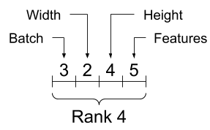
rank_4_tensor = tf.zeros([3, 2, 4, 5])
print("Type of every element:", rank_4_tensor.dtype)
print("Number of dimensions:", rank_4_tensor.ndim)
print("Shape of tensor:", rank_4_tensor.shape)
print("Elements along axis 0 of tensor:", rank_4_tensor.shape[0])
print("Elements along the last axis of tensor:", rank_4_tensor.shape[-1])
print("Total number of elements (3*2*4*5): ", tf.size(rank_4_tensor).numpy())
Results:
Type of every element: <dtype: 'float32'>
Number of dimensions: 4
Shape of tensor: (3, 2, 4, 5)
Elements along axis 0 of tensor: 3
Elements along the last axis of tensor: 5
Total number of elements (3*2*4*5): 120
Notes:
So, in code: We make a rank-4 tensor, then interrogate it about all its features.
Here, we see dtype, and shape, number of dimensions, each dimension of which we'd call an axis,
While axes are often referred to by their indices, you should always keep track of the meaning of each. Like, batch, width, height, and the feature itself, like a color.
Often axes are ordered from global to local: The batch axis first, followed by spatial dimensions, and features for each location last. This way feature vectors are contiguous regions of memory.

Slide 31
Core ops
Operations on tensors
tf.matmul, tf.multiply, tf.min, tf.argmax
+, -, /, @, and other overrides
[:] slicing operators, tf.concat
Notes:
You can then do math on them as you'd expect using overrides, and the results execute immediately.
matmul, min, argmax
various overridden operators
and slicing operators that you might find in, like, numpy

Slide 32
Core ops
Operations on tensors
tf.matmul, tf.multiply, tf.min, tf.argmax
+, -, /, @, and other overrides
[:] slicing operators, tf.concat
a * b # element-wise multiplication
a @ b # matrix multiplication
tf.add(a, b)
print("From 2, before 7:", rank_1_tensor[2:7].numpy())
Notes:
Here is a little code: element-wise multiply, a matrix multiplication, element-wise addition without the operator overload, and then some slicing.
Normally, when you call these, they just return their results right away, so it should feel very Pythonic.

Slide 33
Specialized Ops
tf.nn.conv2d
tf.nn.relu
tf.nn.softmax
tf.linalg.cholesky
tf.nn.embedding_lookup
Relu is just tf.math.maximum(features, 0)
Notes:
And there are a whole buncha other useful ops that you can use. Lots of specialized operators that do ML-like things, relu (which you use for activations), 2d convolutions, softmax, compute the [CHO-less-key] Cholskey decomposition of square matrices, or lookup something in an embedding.
A lot of these ops, like relu, can be easily implemented in lower-level fragments of TensorFlow [click], but we like to have bigger-scale ops here both for convenience (how often will your write Cholesky decomposition correctly on the first try?) and as an implementation these common operations are "fused" internally for efficiency.

Slide 34
Checkpoint!
We have tensors
What if need to describe a parameter?
Notes:
Checkpoints are popular in machine learning, so let's checkpoint what we've learned so far.
#1 we have tensors! But...what if I need to describe a something that can change, like a parameter of a machine learning model?

Slide 35
Variables
Where you store your changes
Notes:
Tensors are great, because they are immutable, which makes optimization and refactoring possible, including letting the graph optimizer fold constants and so forth.
However, every machine learning model is made out of changeable parameters. You can't just store these in Python variables, as it'll be really slow, so TensorFlow has a special data type for this.

Slide 36
Creating variables
my_tensor = tf.constant([[1.0, 2.0], [3.0, 4.0]])
my_variable = tf.Variable(my_tensor)
# Variables can be all kinds of types, just like tensors
bool_variable = tf.Variable([False, False, False, True])
complex_variable = tf.Variable([5 + 4j, 6 + 1j])
Notes:
A variable looks and acts like a tensor, and, in fact, is a data structure backed by a tf.Tensor. Like tensors, they have a dtype and a shape, and can be exported to NumPy.
Let's make a few here...
We have a regular 2d tensor and use it to initialize a variable
We can also have boolean and complex variables---variables can be any supported type

Slide 37
Updating variables
a = tf.Variable([2.0, 3.0])
# This will keep the same dtype, float32
a.assign([1, 2])
# Not allowed as it resizes the variable:
try:
a.assign([1.0, 2.0, 3.0])
except Exception as e:
print(f"{type(e).__name__}: {e}")
Notes:
Most of the time, variables act like tensors.
However, you can reassign the variable using tf.Variable.assign. Calling assign does not (usually) allocate a new tensor; instead, the existing tensor's memory is reused.
Because this a data structure wrapped around a tensor
For ops, it should be about as fast
However, because it allows updating, you can't reshape

Slide 38
Placing variables on devices
tf.debugging.set_log_device_placement(True)
with tf.device('CPU:0'):
a = tf.Variable([[1.0, 2.0, 3.0], [4.0, 5.0, 6.0]])
b = tf.Variable([[1.0, 2.0, 3.0]])
with tf.device('GPU:0'):
# Element-wise multiply
k = a * b
Notes:
For better performance, TensorFlow will attempt to place variables, and Tensors as well, on the fastest device compatible with its dtype. This means most floating point variables are placed on a GPU if one is available.
However, you can override this. In this snippet, place a float variable on the CPU and a computation with it on the first GPU.
In most cases, you wouldn't want to do this unless you knew something special about how the variable is used.
Getting great performance out of TensorFlow does mean you need to think about which devices are doing which work, and the pipelines that connect them all. However, even though manual placement works, you probably won't do it manually like this very often.

Slide 39


One machine, multiple GPUs
Notes:
It's a field of active research to decide how to place tensors and move data around. The good news is that TensorFlow comes built in with Distribution strategies that let you write code once and use it on lots of different kinds of training setups, whether you have one machine with multiple GPUs like this, or lots of CPUs each with their own GPUs. Or even TPUs and TPU pods!
All of which is another talk for another time.
All right, getting back to variables, though....

Slide 40
Ops and lifespan
w = tf.Variable([1.0, 2.0, 3.0])
b = tf.Variable(2.0)
x = tf.constant([2.0, 3.0, 4.0])
y = w * x + b # <tf.Tensor: [ 4., 8., 14.], dtype=float32)>
# Explicitly remove the Python object
del(w)
Notes:
Just like tensors, you can do do math with variables, and you can mix and match tensors and variables. The output of this combination of variables and tensors is a tensor. So, x is the input data to y = wx + b
In Python-based TensorFlow, tf.Variable and Tensor instances have the same lifecycle as other Python objects. When there are no references to a variable or Tensor it will get garbage collected, and that includes ones placed on accelerators.
[breath]
A passing note about deallocating memory: You might notice that when you explicitly deallocate a tensor or variable on a GPU, you won't see the GPU memory allocation go down; that's because the runtime is reserving it for later.

Slide 41
Checkpoint!
We have tensors
We have variables
You could imagine a world where you can do the forward pass of a network
But what about training?
Notes:
OK, so, checkpoint!
We have tensors
We have variables
You could imagine a world where you can do the forward pass of a network---we have data, variables, and ops!
But what about training?

Slide 42
Modules
Collecting all your stuff
Notes:
This brings us to modules.
In the last example, I snuck in a little piece of functionality---we looked up all the variables associated with a dense layer.

Slide 43
Collecting variables
tf.Module is the base class for collecting variables, saving them, checkpointing them.
Model
Weights
Notes:
It's very helpful to have a place that automatically collects your variables.
You also want to create classes that can contain all the math you want to do, as many neural networks have lots of repeating structures in them.
Since TensorFLow lets you define your models in Python, Modules are a pythonic ways of gathering all this functionality together.

Slide 44
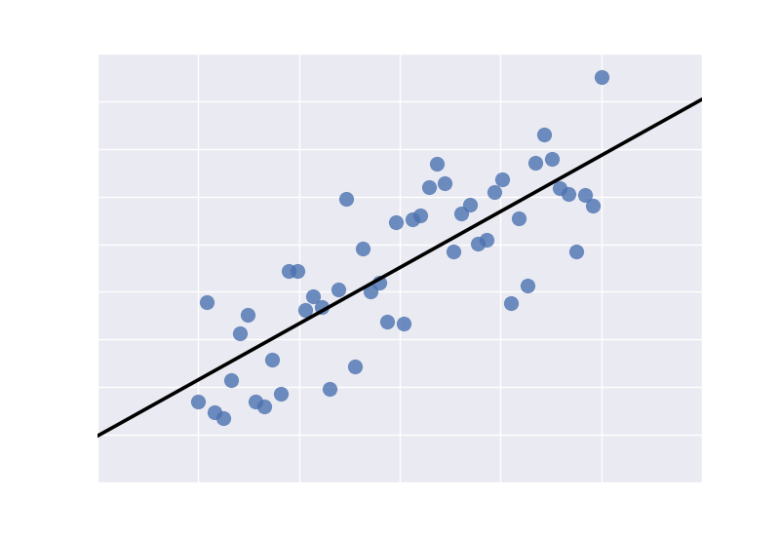
Linear Regression
result
input
y = Wx + b
parameters
Notes:
For future reference, going forward we will be referring to this example a lot:
A linear regression, where we have the y= Wx +b. x is the input, W and b are parameters that you are tuning to try to predict the output y from x. Then we get that nice clean line that's the best guess of the relationship between x and y.
machine learning, this kind of operation can be called a Dense layer, or sometimes a linear layer

Slide 45
Creating a layer
class Dense(tf.Module):
def __init__(self, in_features, out_features, name=None):
super().__init__(name=name)
self.w = tf.Variable(
tf.random.normal([in_features, out_features]), name='w')
self.b = tf.Variable(tf.zeros([out_features]), name='b')
def __call__(self, x):
y = tf.matmul(x, self.w) + self.b
return tf.nn.relu(y)
Notes:
In Python, it's easy enough to make a linear regression layer----you extend tf.Module and then define an init that allocates your variables, and a __call__ override that does the math. Here we're doing the relu activation as well.
By defining __call__, we're making this into a Python callable, which means we can treat it like a function.

Slide 46
Creating a multilayer model
class SequentialModule(tf.Module):
def __init__(self, name=None):
super().__init__(name=name)
self.dense_1 = Dense(in_features=3, out_features=3)
self.dense_2 = Dense(in_features=3, out_features=2)
def __call__(self, x):
r = self.dense_1(x)
return self.dense_2(r)
Notes:
A multilayer model is pretty much the same thing---more than one layer. Since we've already defined Dense, we just use it here in our sequential module that calls two dense layers≥
In call, we first all dense_1, then dense_2. We could just directly call dense2 on the result of dense1, but you'll probably want to debug it as you're writing your model, and this way you can use printf on r to check your shapes and whatnot.
[point to slide, go through stuff], talk about dense_2, dense_1 and printf
You can see in call, we're just calling the layers on whatever is being passed in; usually tensors, although tensor ops will convert numpy ndarrays and Python lists to tensors automatically; in this case, the results will always be tensors, and r, there, the intermediate result, is also a tensor.

Slide 47
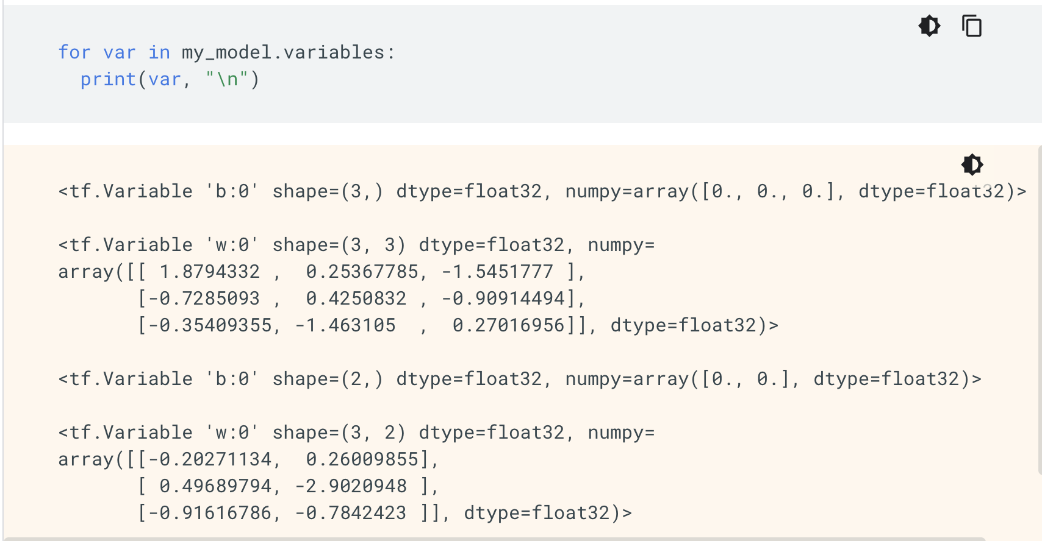
Notes:
tf.Modules are built specifically to collect variables, and they collect them recusively.
In this example, we're asking this sequential model, hey, tell us your variables, and it tells us. It's got two sets of bs, and two sets of ws, each attached to a different layer. They're slightly different shapes because the last layer only has two outputs.
You can see how immediately useful this is in context of our last example where we were calculating gradients that were the same shape as the variables---we want to be able to apply the gradients directly to the variables.

Slide 48
Saving: Two ways
Variables: All the weights in your models + some metadata
checkpoint = tf.train.Checkpoint(model=my_model)
checkpoint.write(chkp_path)
Graph: Run this without the original source, you also need to save the graph + weights (this is a preview of the next section!)
tf.saved_model.save(a_function, "the_saved_model")
Notes:
Any function can be saved as a saved model. This saves two pieces---the graph trace and the weights at the time it was saved.
Variable checkpoints are just the weights. We'll get to the graph a bit later.

Slide 49
Keras layers are modules
tf.Module is the base class for collecting variables, saving them, checkpointing them.
Notes:
Last thing I'll say about modules is that, if you know what keras is, keras layers are, actually, modules; they inherit from tf.module. that means you can interrogate keras layers for their variables and submodules with the same methods; Keras layers come with a bunch of other handy convenience functions, as well, and they work within the entire Keras framework.
For historical reasons, you should choose either pure tf.Module or tf.keras.Layer as your base class.

Slide 50
Checkpoint!
We have tensors
We have variables
You can do the forward pass of a network
You can do the backwards pass to calculate gradients
We can make a model and save it!
But what about training?

Slide 51
There's so much more!
Notes:
High level APIs have idiomatic coding you want to learn
Low-level stuff might just be tf.numpy, which is coming soon
Distribution strategies, TPU pods, all that
Getting data into your model with tf.data
And, of course, putting your models in production is a whole field of study unto itself.

Slide 52
Contact me
Linkedin.com/in/usmanniazi99
Instagram.com/_usmanniazi
Github.com/usmanniazi

Slide 53
Thank you!
Learn more
tensorflow.org/tutorials
tensorflow.org/guide <-- See "TensorFlow Basics" for this talk
Stay up to date
blog.tensorflow.org
youtube.com/tensorflow
twitter.com/tensorflow
Notes:
Note: if you’re giving this talk in China, please replace these links with the appropriate versions (wechat) and chang tensorflow.org link to tensorflow.google.cn
Thanks so much for your time!
Everything we talked about here is on TensorFlow.org in guides and tutorials.
The best way to stay up to date is to watch our social channels [WeChat? Bilibili?].
Thanks again!

